Slide 1

Final Project
Course : Applied Computational Intelligence
Instructor name: Dr. Ken Ferens
Student name: Mana Zandvakili
Student ID: 8034630
Department: Electrical and Computer Engineering

Slide 2
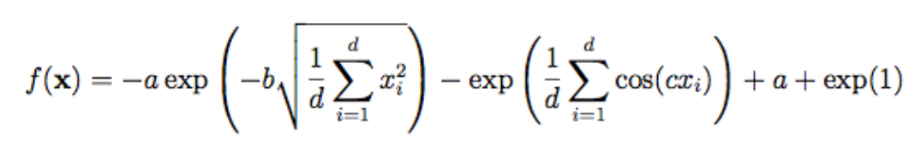
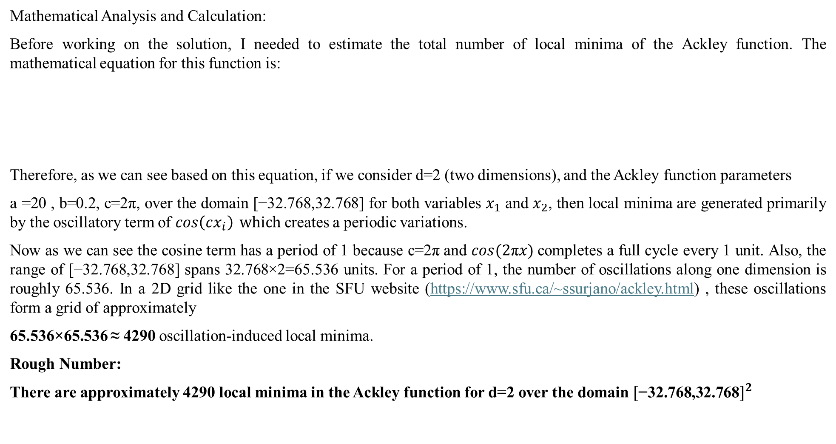
Modify the given SA code of Project 4 to search for as many local minima as possible in a hypercube of the Ackley cost function.
Mathematical Analysis and Calculation:
Before working on the solution, I needed to estimate the total number of local minima of the Ackley function. The mathematical equation for this function is:
Therefore, as we can see based on this equation, if we consider d=2 (two dimensions), and the Ackley function parameters
a =20 , b=0.2, c=2π, over the domain [−32.768,32.768] for both variables $x_{1}$ and $x_{2}$, then local minima are generated primarily by the oscillatory term of $\cos\left(cx_{i}\right) which$creates a periodic variations.
Now as we can see the cosine term has a period of 1 because c=2π and $\cos{(2\text{π}x)}$completes a full cycle every 1 unit. Also, the range of [−32.768,32.768] spans 32.768×2=65.536 units. For a period of 1, the number of oscillations along one dimension is roughly 65.536. In a 2D grid like the one in the SFU website (https://www.sfu.ca/~ssurjano/ackley.html) , these oscillations form a grid of approximately
65.536×65.536 ≈ 4290 oscillation-induced local minima.
Rough Number:
There are approximately 4290 local minima in the Ackley function for d=2 over the domain ${[\text{−32.768,32.768}]}^{2}$

Slide 3
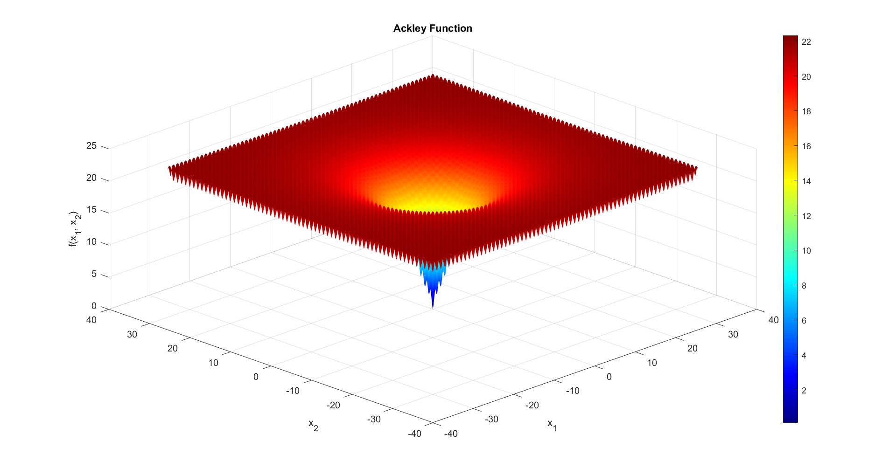
1. By visually counting them, how many local minima are there in this hypercube?
Based on this observation, we estimate there are approximately 65 local minima on each side of the square. By calculating the square's area, we can say that there are around 4225 local minima in total.
File name:
Ackley_Rep_param.m
≈ 65
≈ 65

Slide 4
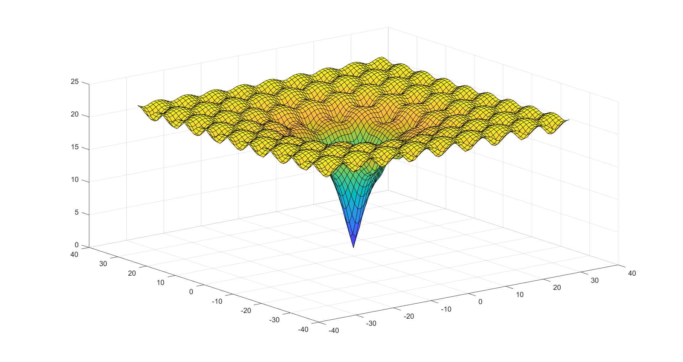
1. By visually counting them, how many local minima are there in this hypercube?
If we adjust the parameters 𝑎, 𝑏, and 𝑐, the Ackley function takes on a different form, making it countable. However, with the predefined values for 𝑎, 𝑏, and 𝑐, it will appear as shown in the previous slide. In this picture are around 81 local minima.
File name:
Ackley_Rep.m

Slide 5
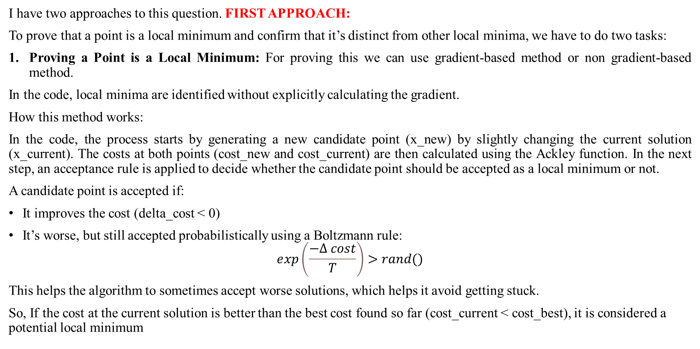
3. In addition to the visual verification, provide an objective verification that each of your local minimum is different than your other local minima.
I have two approaches to this question. FIRST APPROACH:
To prove that a point is a local minimum and confirm that it’s distinct from other local minima, we have to do two tasks:
Proving a Point is a Local Minimum: For proving this we can use gradient-based method or non gradient-based method.
In the code, local minima are identified without explicitly calculating the gradient.
How this method works:
In the code, the process starts by generating a new candidate point (x_new) by slightly changing the current solution (x_current). The costs at both points (cost_new and cost_current) are then calculated using the Ackley function. In the next step, an acceptance rule is applied to decide whether the candidate point should be accepted as a local minimum or not.
A candidate point is accepted if:
It improves the cost (delta_cost < 0)
It’s worse, but still accepted probabilistically using a Boltzmann rule:
$$ⅇxp\left(\frac{−Δ cost}{T}\right)>rand()$$
This helps the algorithm to sometimes accept worse solutions, which helps it avoid getting stuck.
So, If the cost at the current solution is better than the best cost found so far (cost_current < cost_best), it is considered a potential local minimum

Slide 6
3. In addition to the visual verification, provide an objective verification that each of your local minimum is different than your other local minima.
2. Proving a Point is Distinct from Others: We can easily set a minimum distance (threshold) and say that if it is within that distance, then it is distinct from other local minima. We will find the distance between that point and others using Euclidean distance.
So this method basically relies on exploration of the solution space and cost comparison to determine if a point is a local minimum.
Why didn’t we use a gradient-based method?
The first reason is that the Ackley function is non-convex and has many local minima across the search space. Computing gradients for such functions can be very computationally expensive and sometimes even doesn’t have a good advantage in our optimization process. The second reason is that, after a little bit of search on the internet and reading a couple papers, I understand that actually the simulated annealing is designed to work without gradient information, since it is based on probabilistic acceptance of solutions and gradually decreasing the randomness (using cooling procedure). Therefore, this algorithm is suitable for problems where calculating the gradient is not feasible.
I have two approaches to this question. SECOND APPROACH:
The second approach that worked really well for me was to consider each point along with the eight neighboring points — north, south, east, west, and the four diagonals. I would then check the cost of these eight neighboring points compared to the cost of the center point (the one I was considering). If the cost of the center point was lower than all the others, I could say it was a local minimum. To make sure this minimum was distinct from others, I calculated its Euclidean distance to the other identified minima. If the distance was greater than a certain threshold, I would consider it a distinct local minimum.

Slide 7
4. Explain the modifications to your SA code for this purpose. In particular, explain how you generated your initial solution, and give an example of your initial solution. Also, explain how you performed a step in solution space during the Equilibrium loop, how you computed the cost, and how you forced SA to do exploration, exclusively.
FIRST APPROACH:
I made extensive changes to the basic SA code so that it focuses on finding all the local minima rather than just the global minimum.
To achieve this, I combined SA with PSO. This combination improves the algorithm, especially for complex functions like the Ackley function, which has a large number of local minima across the search space.
The reason this approach works well is that first PSO exploring the search space and locating multiple promising regions where local minima are likely to exist. After finding these regions by PSO, SA takes over and conducts a detailed search within each region to identify distinct local minima. This approach is more effective compared to using SA alone because with just SA, the algorithm’s performance depends on its initial starting point, which might not be optimal, and this can cause the loss of many local minima because SA is by nature slower at exploring the entire search space. By adding PSO, we will make sure that SA starts its search near promising regions which can increase the likelihood of finding more local minima.
File name:
First_Algo_Zandvakili.m

Slide 8
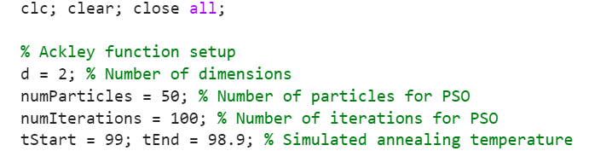
4. Explain the modifications to your SA code for this purpose. In particular, explain how you generated your initial solution, and give an example of your initial solution. Also, explain how you performed a step in solution space during the Equilibrium loop, how you computed the cost, and how you forced SA to do exploration, exclusively.
FIRST APPROACH:
Now, let me explain the code step by step, and then I’ll answer the specific questions:
In the first part of the code, I set up the Ackley function parameters. Here I define its dimension as 2 (based on the SFU website). Next, I define the parameters for PSO, such as the number of particles and the number of iterations. These settings are important because PSO helps locate promising regions in the search space for SA to refine later. Then, I set up the starting and ending temperatures for SA. This step is important for improving the algorithm. The main goal of SA in this problem is exploration, not exploitation. Unlike the typical SA approach, where the temperature starts high and gradually decreases to focus on exploitation (i.e., finding the global minimum), this problem requires us to find all local minima. To do so, I keep the starting and ending temperatures close to each other and make sure the algorithm explores multiple areas of the search space without converging to a global minimum. This change aligns with the objective of finding local minima rather than the global minimum.

Slide 9
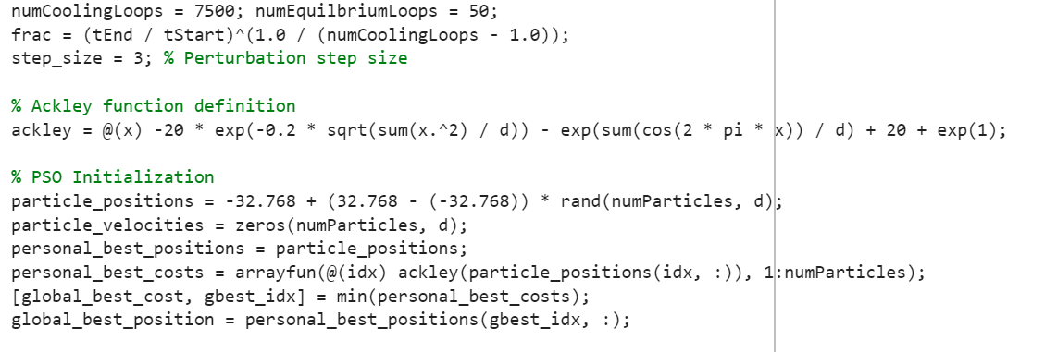
4. Explain the modifications to your SA code for this purpose. In particular, explain how you generated your initial solution, and give an example of your initial solution. Also, explain how you performed a step in solution space during the Equilibrium loop, how you computed the cost, and how you forced SA to do exploration, exclusively.
FIRST APPROACH:
In the next step, I set the numbers for the cooling and equilibrium loops. The key here is that the number of cooling loops should be much higher than the equilibrium loops to focus on exploration rather than exploitation. The frac parameter is the same as in the basic SA algorithm. I also defined the step size for perturbation in this section.
Then, I included the mathematical equation for the Ackley function.
Next, I initialized the PSO. Here’s what I did: each particle's position is initialized randomly within the search space [−32.768,32.768]^2 for two dimensions. The initial velocity for all particles is set to zero but velocities will be updated during the PSO iterations as particles adjust their movement based on their own experiences and the group’s best findings. Each particle's current position is initially set as its personal best position, and the cost at that position is calculated using the Ackley function. Among all particles, the one with the lowest cost (the best solution so far) is identified as the global best. Its corresponding cost and position are then stored in global_best_cost and global_best_position, respectively.

Slide 10
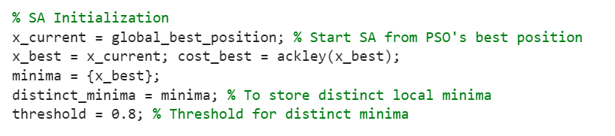
4. Explain the modifications to your SA code for this purpose. In particular, explain how you generated your initial solution, and give an example of your initial solution. Also, explain how you performed a step in solution space during the Equilibrium loop, how you computed the cost, and how you forced SA to do exploration, exclusively.
FIRST APPROACH:
The next part of the code involves initializing the SA process, which is combined with the PSO results. The SA process starts from the global best position found by PSO. The current position (x_current) is also set as the best solution initially, and its cost is calculated using the Ackley function and stored in cost_best. The first local minimum is initialized as the current position (x_best) and stored in a cell array called minima, which tracks all local minima found during the process. Additionally, another cell array, distinct_minima, is initialized to track only the distinct local minima. To make sure that minima are considered distinct, I defined a threshold of 0.8. After closely visualizing the Ackley function, I found out that most valleys are separated by approximately 0.8 units. This threshold is used to define the minimum distance required between two minima for them to be classified as distinct.

Slide 11
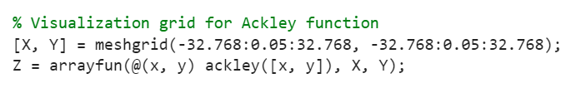
4. Explain the modifications to your SA code for this purpose. In particular, explain how you generated your initial solution, and give an example of your initial solution. Also, explain how you performed a step in solution space during the Equilibrium loop, how you computed the cost, and how you forced SA to do exploration, exclusively.
FIRST APPROACH:
After setting up the parameters, I visualized the Ackley function in 3D using the meshgrid command to define a grid for the x and y axes. The z-axis was then calculated based on the Ackley function values to create a detailed 3D plot of the function's surface.
In the next part, we have the optimization part:
In this part, I update the particle’s velocities, each particle's velocity is updated using three components: The first component is inertia which is the particle's current velocity multiplied by a constant (0.7) to maintain momentum. The second component is self component, in which each particle is pulled toward its personal best position and scaled by a random factor (rand()). The third component is social component which is each particle also attracted toward the global best position, again influenced by a random factor. The total velocity is a combination of these three components.
In the next part, each particle's position is updated by adding its velocity to its current position. However, we should consider that the valid solutions are restricted to stay within the Ackley function's domain of [-32.768, 32.768]. Then, the Ackley function cost is computed for the particle's updated position, and if this new cost is better than the particle's previous personal best, both the personal best cost and position are updated. After that, among all particles, the one with the lowest cost (best solution) is identified as the global best and if this new global best cost is better than the previous global best, the global best cost and position are updated.

Slide 12
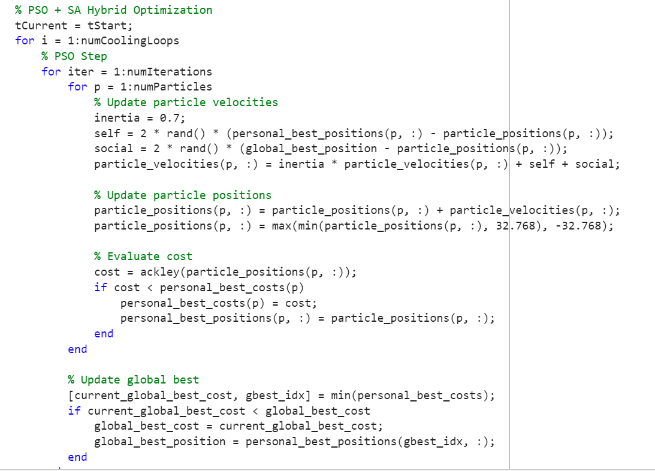
4. Explain the modifications to your SA code for this purpose. In particular, explain how you generated your initial solution, and give an example of your initial solution. Also, explain how you performed a step in solution space during the Equilibrium loop, how you computed the cost, and how you forced SA to do exploration, exclusively.
FIRST APPROACH:

Slide 13
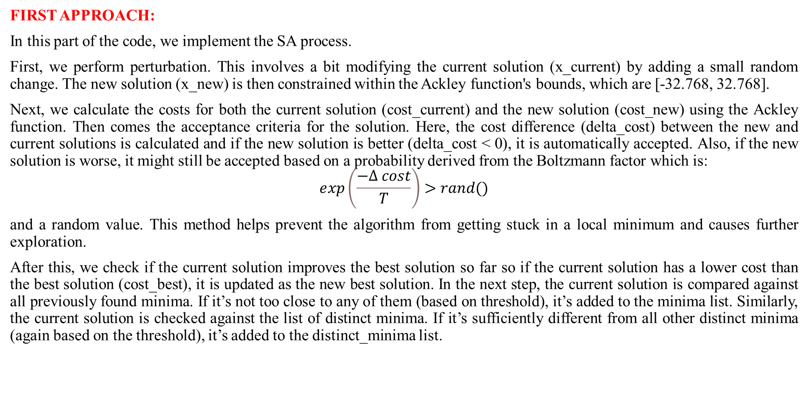
4. Explain the modifications to your SA code for this purpose. In particular, explain how you generated your initial solution, and give an example of your initial solution. Also, explain how you performed a step in solution space during the Equilibrium loop, how you computed the cost, and how you forced SA to do exploration, exclusively.
FIRST APPROACH:
In this part of the code, we implement the SA process.
First, we perform perturbation. This involves a bit modifying the current solution (x_current) by adding a small random change. The new solution (x_new) is then constrained within the Ackley function's bounds, which are [-32.768, 32.768].
Next, we calculate the costs for both the current solution (cost_current) and the new solution (cost_new) using the Ackley function. Then comes the acceptance criteria for the solution. Here, the cost difference (delta_cost) between the new and current solutions is calculated and if the new solution is better (delta_cost < 0), it is automatically accepted. Also, if the new solution is worse, it might still be accepted based on a probability derived from the Boltzmann factor which is:
$$ⅇxp\left(\frac{−Δ cost}{T}\right)>rand()$$
and a random value. This method helps prevent the algorithm from getting stuck in a local minimum and causes further exploration.
After this, we check if the current solution improves the best solution so far so if the current solution has a lower cost than the best solution (cost_best), it is updated as the new best solution. In the next step, the current solution is compared against all previously found minima. If it’s not too close to any of them (based on threshold), it’s added to the minima list. Similarly, the current solution is checked against the list of distinct minima. If it’s sufficiently different from all other distinct minima (again based on the threshold), it’s added to the distinct_minima list.

Slide 14
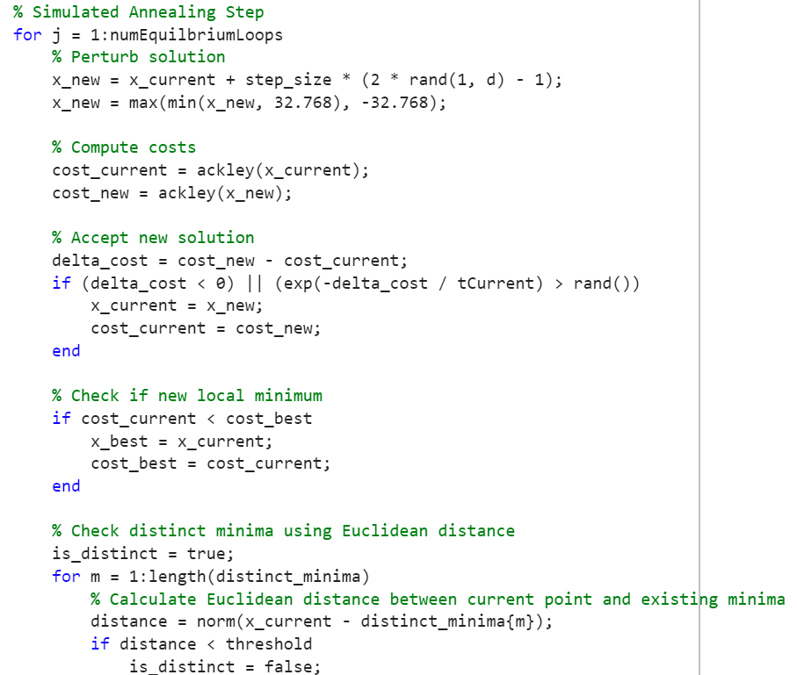
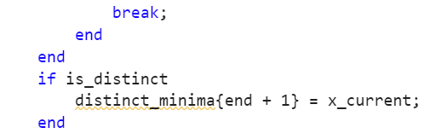
4. Explain the modifications to your SA code for this purpose. In particular, explain how you generated your initial solution, and give an example of your initial solution. Also, explain how you performed a step in solution space during the Equilibrium loop, how you computed the cost, and how you forced SA to do exploration, exclusively.
FIRST APPROACH:

Slide 15
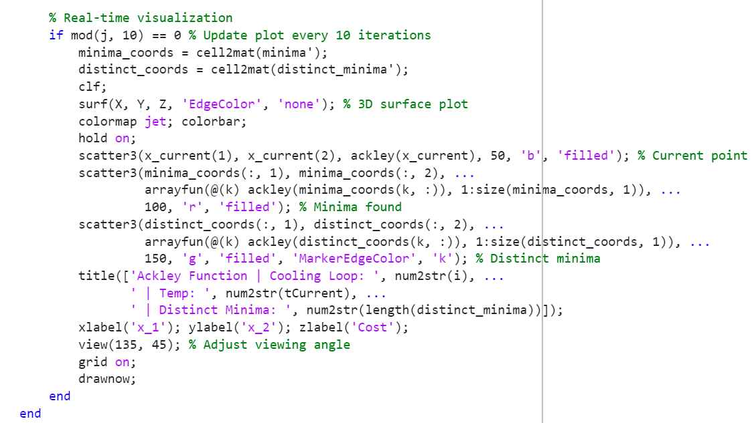
4. Explain the modifications to your SA code for this purpose. In particular, explain how you generated your initial solution, and give an example of your initial solution. Also, explain how you performed a step in solution space during the Equilibrium loop, how you computed the cost, and how you forced SA to do exploration, exclusively.
FIRST APPROACH:
Visualization: This part isn’t important to the code’s functionality; it’s just for real-time visualization of what’s happening. It updates every 10 iterations (mod(j, 10) == 0) to stay efficient. The plot shows the 3D surface of the Ackley function, highlighting key points like the current point (blue dot) and distinct minima (green dots). It also dynamically displays details like the current loop, temperature, and the number of distinct minima found.

Slide 16
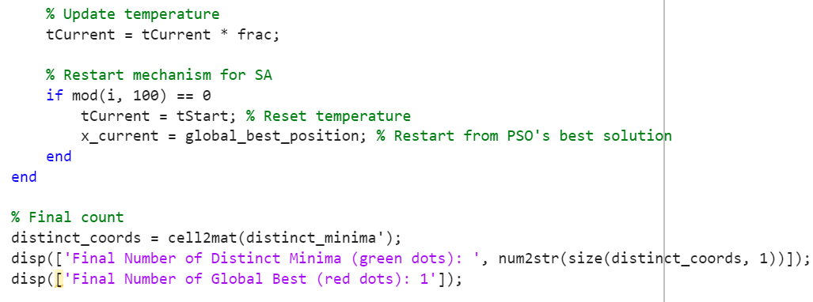
4. Explain the modifications to your SA code for this purpose. In particular, explain how you generated your initial solution, and give an example of your initial solution. Also, explain how you performed a step in solution space during the Equilibrium loop, how you computed the cost, and how you forced SA to do exploration, exclusively.
FIRST APPROACH:
Restart Algorithm: Another helpful addition I made, which I think is necessary, is the restart mechanism. In this type of algorithm, there’s a high chance of getting stuck in local or global minimum. To solve this, the restart mechanism helps reset the search process whenever this happens which allows the algorithm to explore other areas of the solution space. Based on this mechanism every 100 cooling loops (using mod(i, 100) == 0), the algorithm triggers a restart. and then the temperature (tCurrent) is reset to the starting temperature (tStart) to allow the algorithm to re-explore the search space. Also, the current solution (x_current) is reset to the global best position found by the PSO.

Slide 17
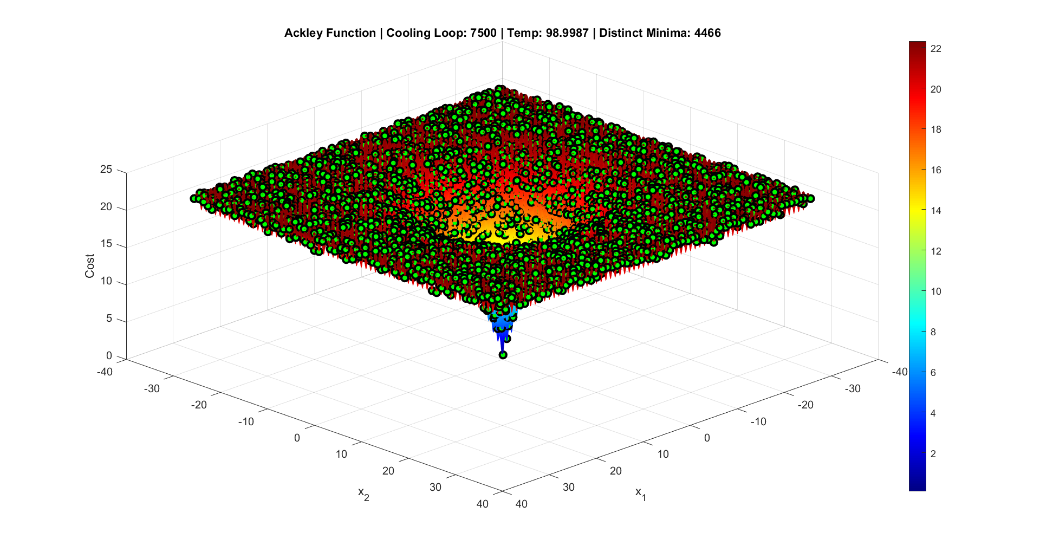
Final Result of First Approach (Forward view)

Slide 18
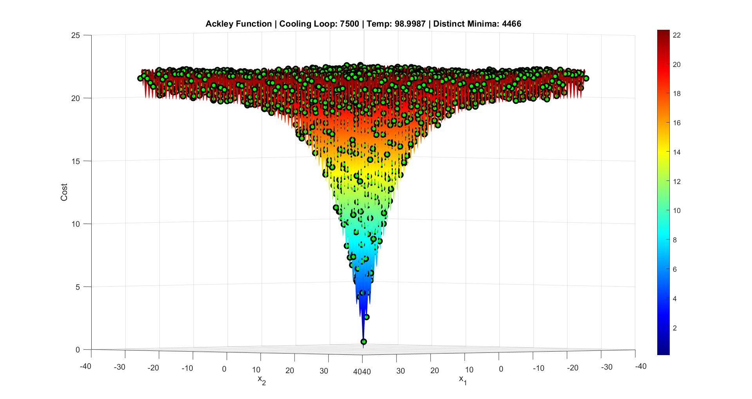
Final Result of First Approach (Forward view)

Slide 19
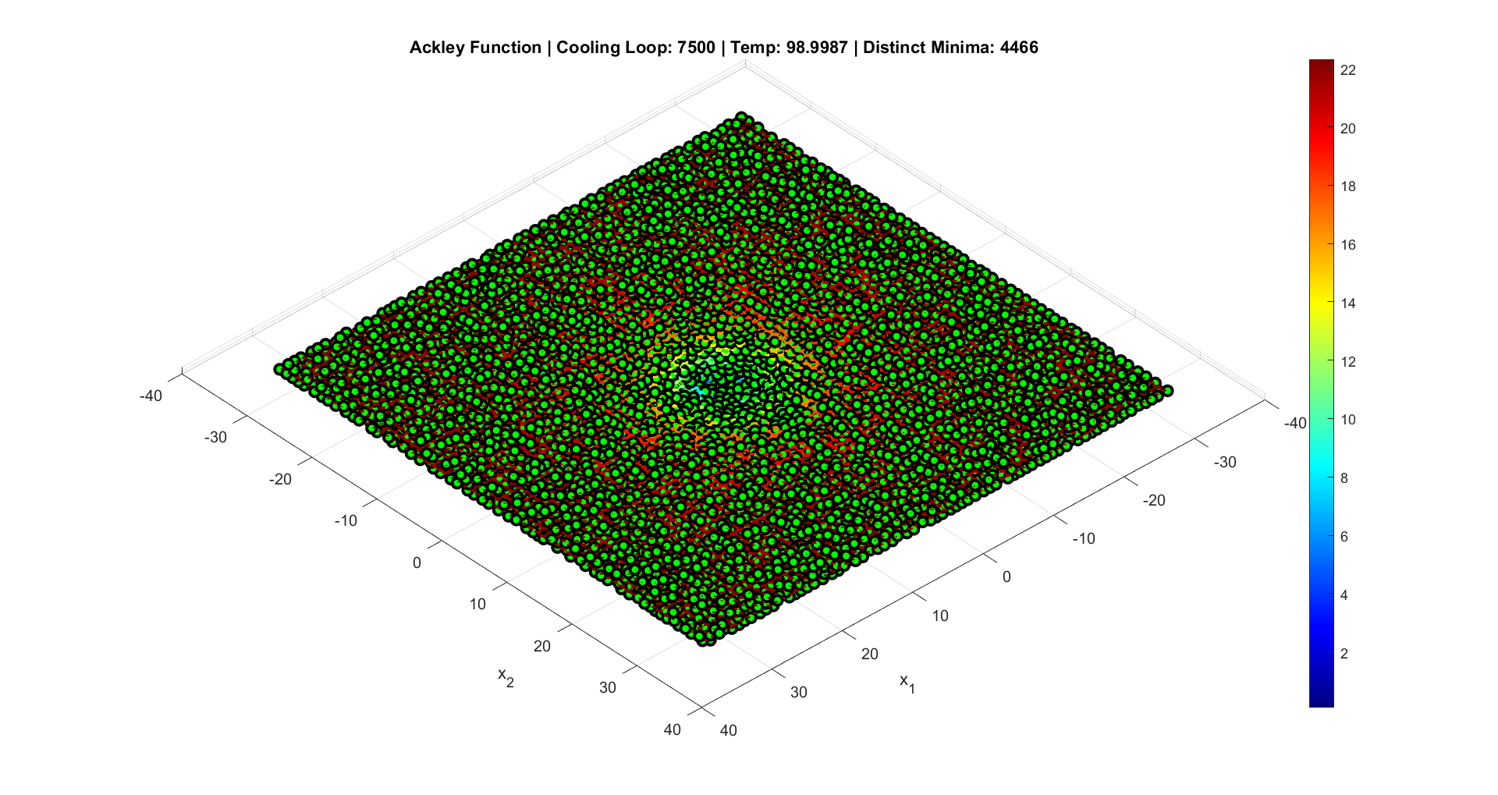
Final Result of First Approach (Top view)

Slide 20
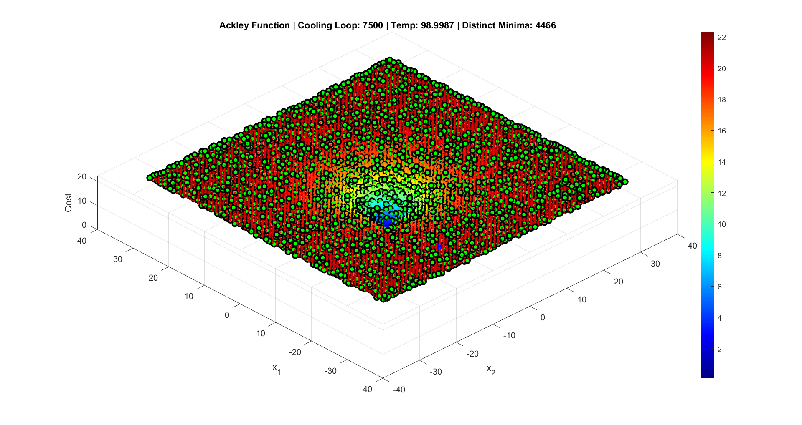
Final Result of First Approach (Bottom view)

Slide 21
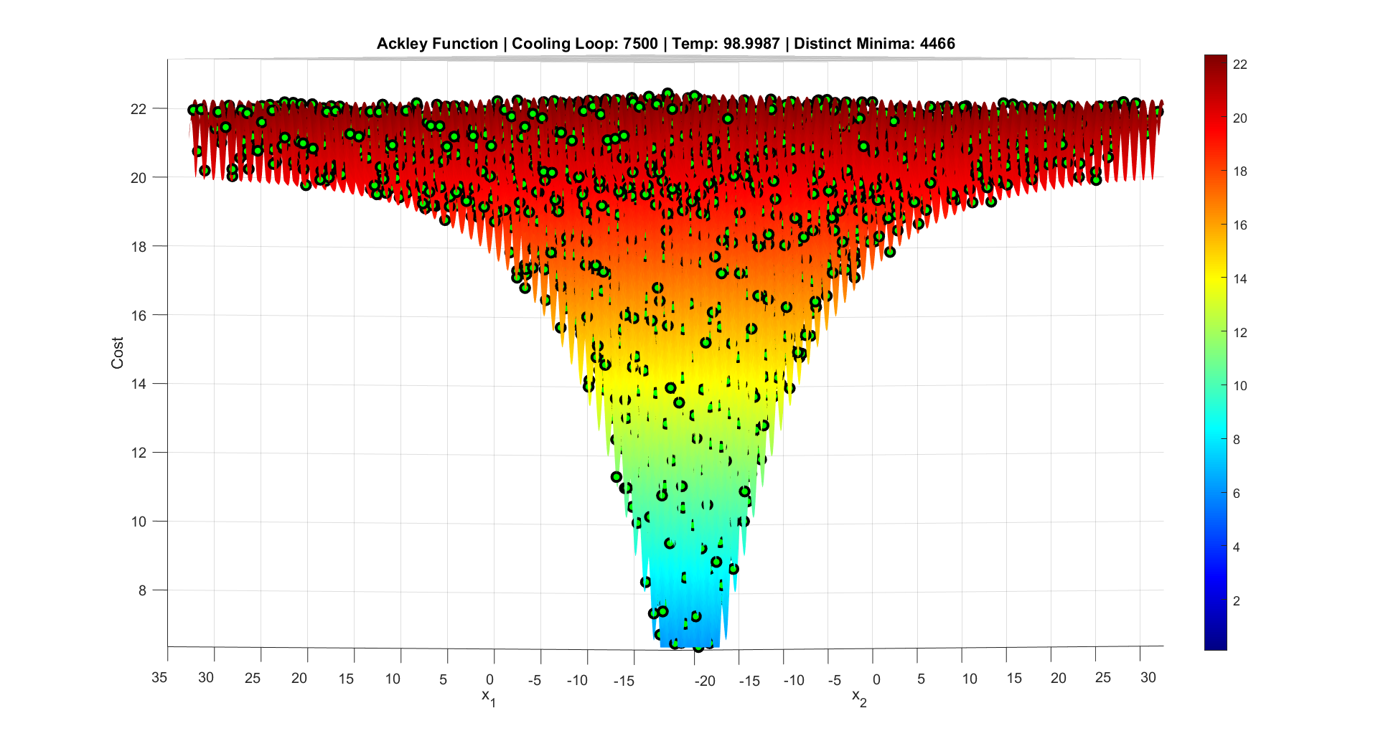
Final Result of First Approach (Zoomed)

Slide 22
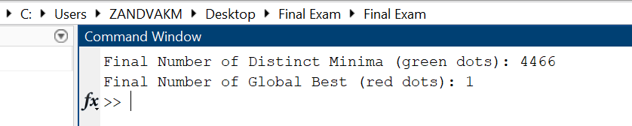
As you can see the total number of local minima found by this method is 4466 and also, 1 global minima

Slide 23
4. Explain the modifications to your SA code for this purpose. In particular, explain how you generated your initial solution, and give an example of your initial solution. Also, explain how you performed a step in solution space during the Equilibrium loop, how you computed the cost, and how you forced SA to do exploration, exclusively.
After the first approach, I realized that PSO was taking a lot of time and made my code computationally intensive which caused it to run for hours. So, I decided to try a different approach, completely omitting PSO. Another thing I understood was that my logic for determining if a point was a local minimum and distinct from others was also computationally expensive and possibly not as accurate as I initially thought. (Still giving the correct answer but not so accurate!)
So, the most optimal code and the best answer is the second code: Second_Algo_Zandvakili.m

Slide 24
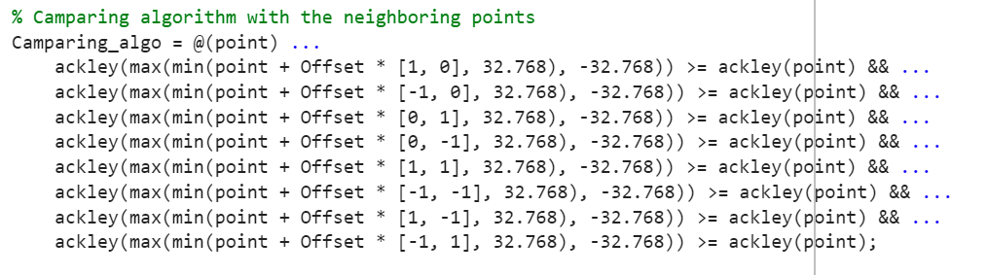
4. Explain the modifications to your SA code for this purpose. In particular, explain how you generated your initial solution, and give an example of your initial solution. Also, explain how you performed a step in solution space during the Equilibrium loop, how you computed the cost, and how you forced SA to do exploration, exclusively.
SECOND APPROACH:
The second approach is similar to the first, so I won’t go into too much detail. The key difference between the two is how we identify local minima and determine if one is distinct from another.
As I mentioned earlier, for each point, we check the cost of eight neighboring points—north, south, east, west, and the four diagonals. We compare these costs with the center point’s cost, and if the center point’s cost is less than its neighbors, we can classify it as a local minimum. To do this, we need to define an offset value that determines how far the center point is from its neighbors. This parameter is defined as offset. This procedure is handled by the Camparing_algo function that will find the cost of the required points and check if the center point’s cost is the lowest.
File name:
Second_Algo_Zandvakili.m

Slide 25
4. Explain the modifications to your SA code for this purpose. In particular, explain how you generated your initial solution, and give an example of your initial solution. Also, explain how you performed a step in solution space during the Equilibrium loop, how you computed the cost, and how you forced SA to do exploration, exclusively.
SECOND APPROACH:
Once we’ve identified a potential local minimum, we calculate the Euclidean distance between the found minima and any new solution. If they are sufficiently far apart based on a defined threshold, we can say the points are distinct.
From this point on, the process follows the same structure as the basic SA code and the first approach. At the end of the process, if both conditions (local minima and distinctness) are met, we have successfully found all the local minima.
Just as a reminder, we also include the restart mechanism to avoid getting stuck in a global minimum.
File name:
Second_Algo_Zandvakili.m

Slide 26
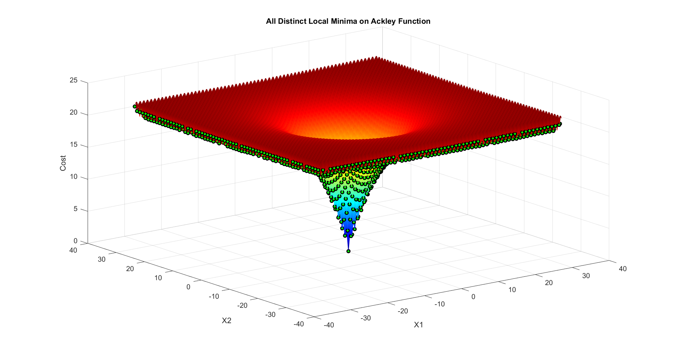
Final Result of Second Approach (Forward view)

Slide 27
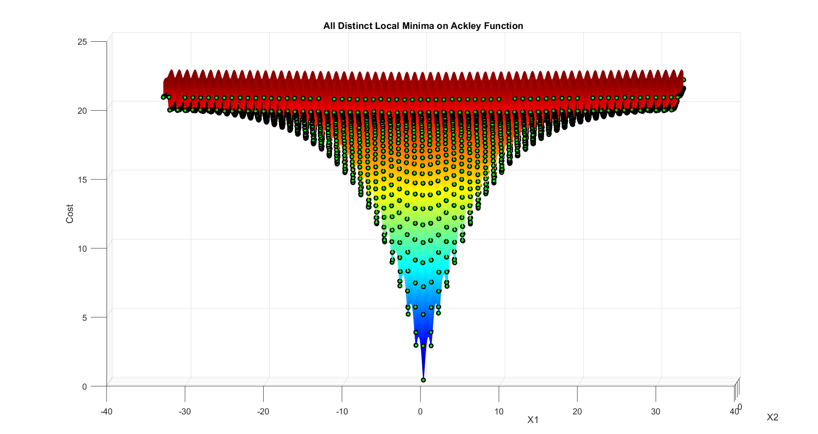
Final Result of Second Approach (Forward view)

Slide 28
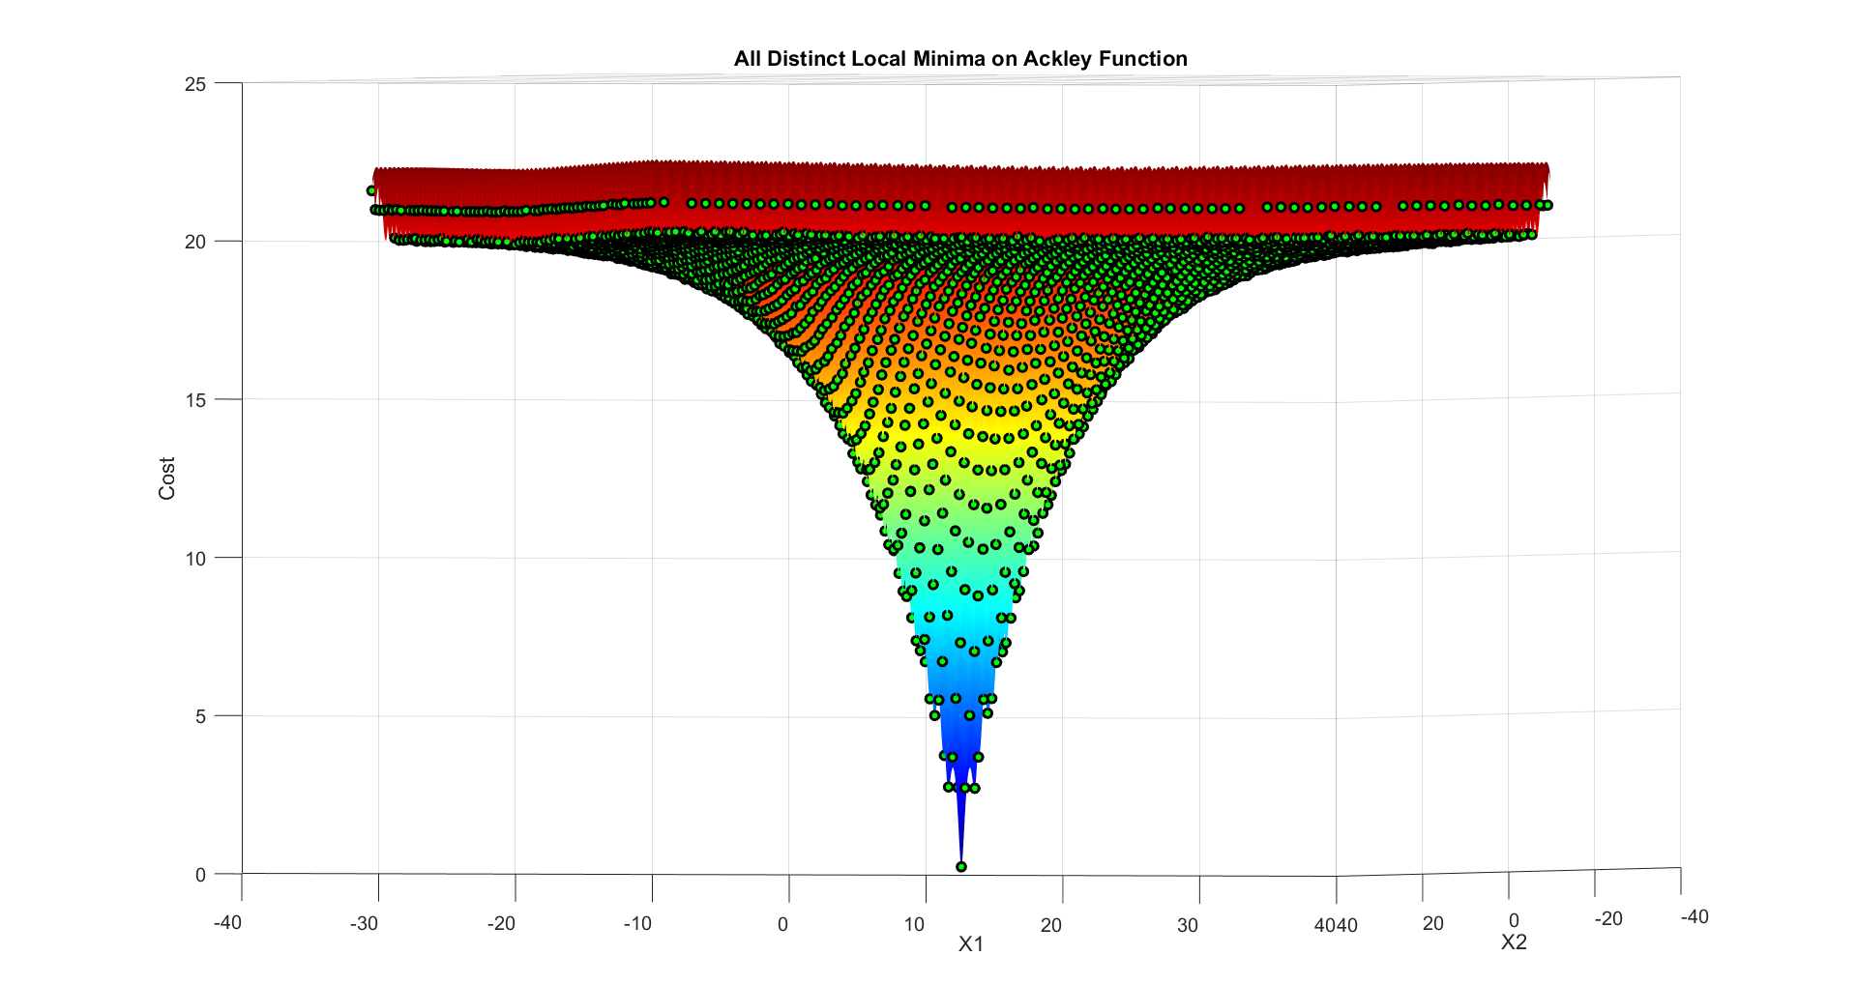
Final Result of Second Approach (Forward view)

Slide 29
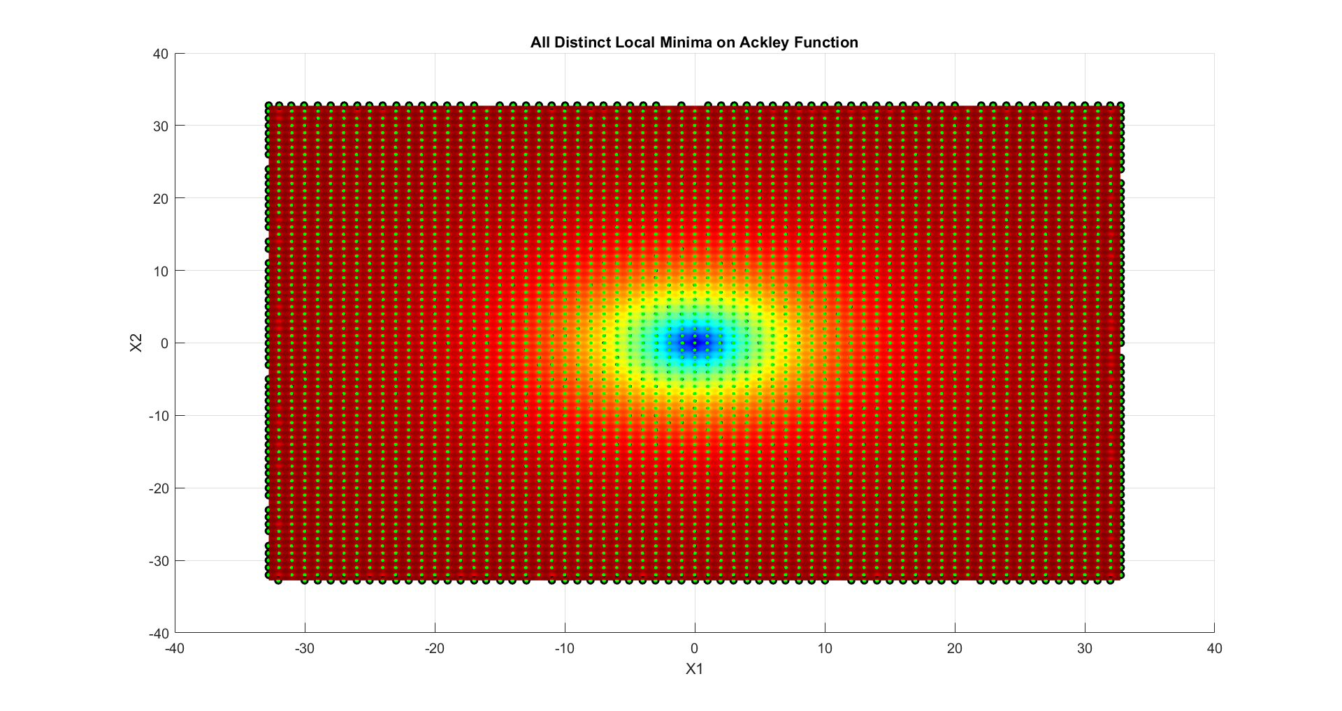
Final Result of Second Approach (Top view)

Slide 30
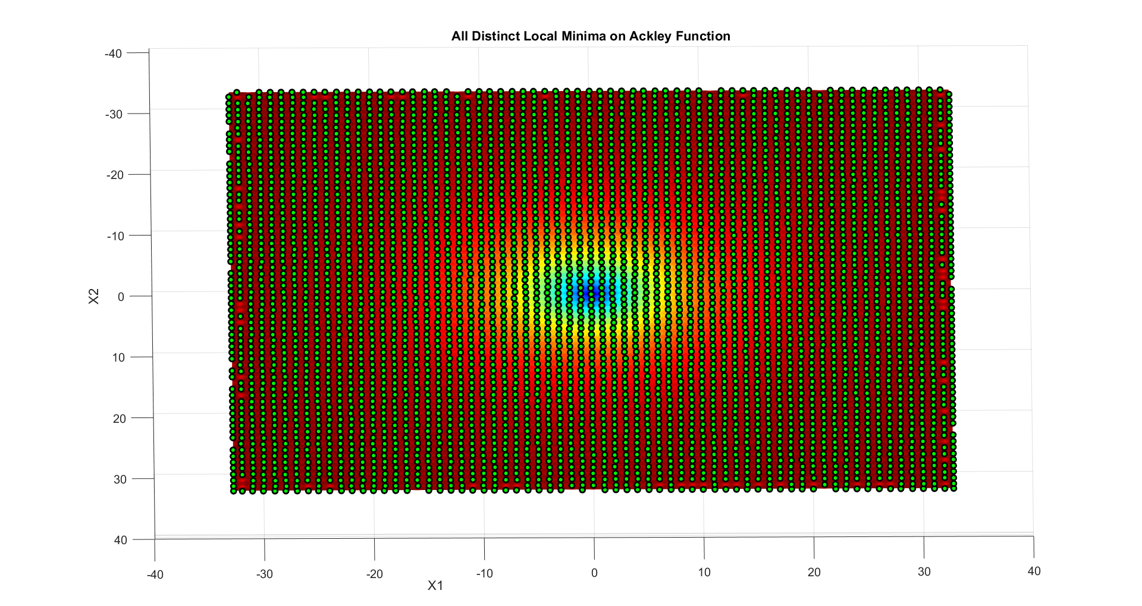
Final Result of Second Approach (Bottom view)

Slide 31
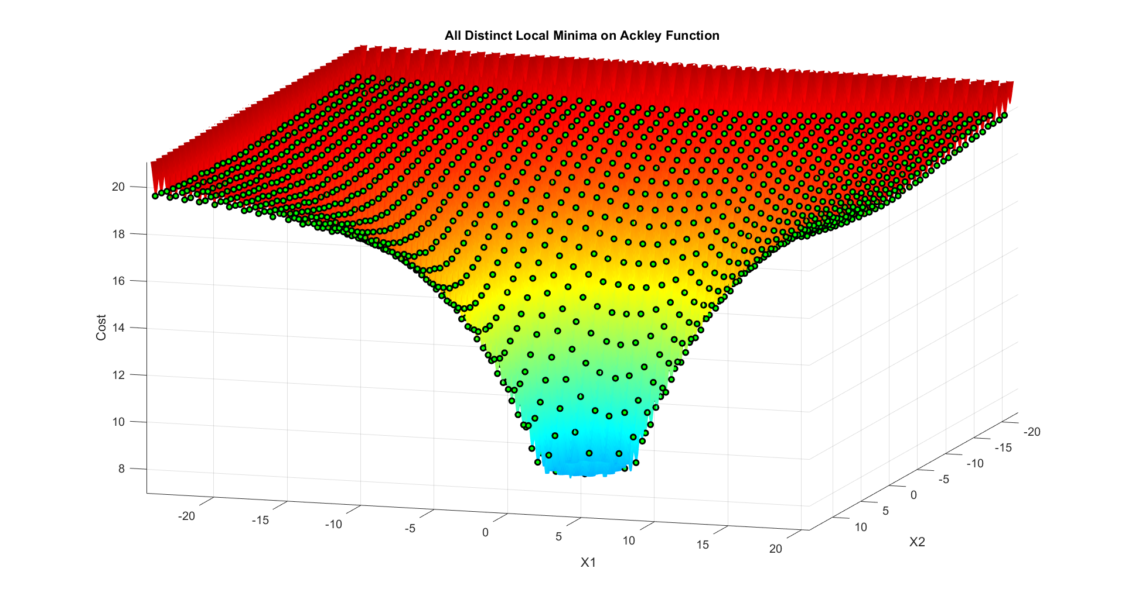
Final Result of Second Approach (Zoomed)

Slide 32
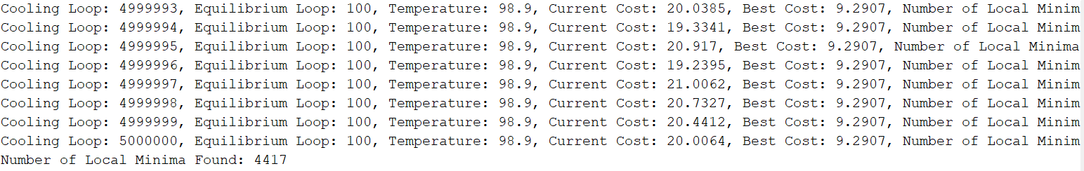
As you can see the total number of local minima found by this method is 4417 and also, 1 global minima

Slide 33
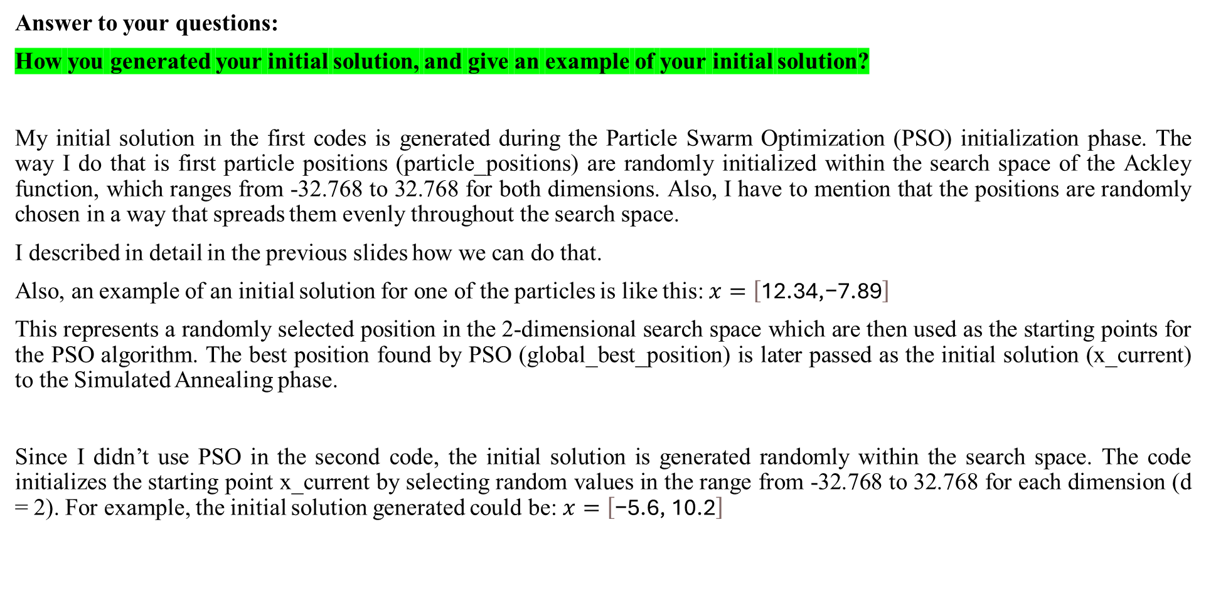
4. In particular, explain how you generated your initial solution, and give an example of your initial solution. Also, explain how you performed a step in solution space during the Equilibrium loop, how you computed the cost, and how you forced SA to do exploration, exclusively.
Answer to your questions:
How you generated your initial solution, and give an example of your initial solution?
My initial solution in the first codes is generated during the Particle Swarm Optimization (PSO) initialization phase. The way I do that is first particle positions (particle_positions) are randomly initialized within the search space of the Ackley function, which ranges from -32.768 to 32.768 for both dimensions. Also, I have to mention that the positions are randomly chosen in a way that spreads them evenly throughout the search space.
I described in detail in the previous slides how we can do that.
Also, an example of an initial solution for one of the particles is like this: $x=\left[\text{12.34,−7.89}\right]$
This represents a randomly selected position in the 2-dimensional search space which are then used as the starting points for the PSO algorithm. The best position found by PSO (global_best_position) is later passed as the initial solution (x_current) to the Simulated Annealing phase.
Since I didn’t use PSO in the second code, the initial solution is generated randomly within the search space. The code initializes the starting point x_current by selecting random values in the range from -32.768 to 32.768 for each dimension (d = 2). For example, the initial solution generated could be: $x=\left[\text{−5.6, 10.2}\right]$

Slide 34
4. In particular, explain how you generated your initial solution, and give an example of your initial solution. Also, explain how you performed a step in solution space during the Equilibrium loop, how you computed the cost, and how you forced SA to do exploration, exclusively.
Answer to your questions:
Explain how you performed a step in solution space during the Equilibrium loop?
In my both codes this step is performed by perturbing the current solution (x_current) to explore the search space.
So, this is how it works:
First a random step is added to the current solution by the below instruction:
x_new = x_current + step_size * (2 * rand(1, d) - 1);
Here the step size determines the magnitude of the step and after trial and error I found out a good step size can be about 3. Alos the rand(1, d) generates a random value between 0 and 1 for each dimension. and at the end this instruction (2 * rand(1, d) - 1) creates random values between -1 and 1 to allow movement in both positive and negative directions. The last thing I did was keeping in mind the new solution stays within the search space bounds ([-32.768, 32.768] for both dimnetions) by using the below instruction:
x_new = max(min(x_new, 32.768), -32.768);

Slide 35
4. In particular, explain how you generated your initial solution, and give an example of your initial solution. Also, explain how you performed a step in solution space during the Equilibrium loop, how you computed the cost, and how you forced SA to do exploration, exclusively.
Answer to your questions:
How you computed the cost?
I explained this question in detail in the previous slides. But just an overview: the cost of a solution is computed by evaluating the Ackley function at a given point in the search space. So basically, to do so first we define the Ackley function, this function takes an input vector x (representing a solution in the search space) and returns a scalar value, which is the cost. Then, we evaluate this cost during each step of the algorithm (e.g., initialization, equilibrium loop), by calling the Ackley function. like below:
cost_current = ackley(x_current);
cost_new = ackley(x_new);
Also, we know that a lower cost indicates a better solution. This cost is used in the simulated annealing acceptance rule to decide whether to accept the new solution (x_new) over the current one (x_current).

Slide 36
4. In particular, explain how you generated your initial solution, and give an example of your initial solution. Also, explain how you performed a step in solution space during the Equilibrium loop, how you computed the cost, and how you forced SA to do exploration, exclusively.
Answer to your questions:
How you forced SA to do exploration, exclusively?
To achieve pure exploration rather than exploitation, I made several changes:
Changing the Starting and Final Temperatures:
I kept the starting and final temperatures very close to each other, maintaining a roughly constant temperature. This prevents the rapid reduction in temperature that causes exploitation in later loops. By keeping the temperature high and stable, the algorithm focuses on exploring the solution space to find the local minima instead of exploitation.
Setting a High Starting Temperature: I set the initial temperature at a high level to avoid the algorithm concentrating on a specific region of the solution space. By this method we are making sure the exploration phase covers broader areas.
Changing the Temperature Schedule (Only in first approach): Instead of using an exponential decay for temperature reduction, I implemented a linear temperature reduction schedule. This slower, decrease causes better exploration throughout the process which gives the algorithm more opportunities to explore new areas.
Acceptance Rule with High Temperature: The high initial temperature increases the acceptance for worse solutions due to the exponential term in the acceptance rule. Even when delta_cost > 0 the high value of tCurrent making sure a greater likelihood of accepting these solutions which causes better exploration.
Larger Perturbation Step Size: I used a relatively large step size for perturbing the solution, which causes jumps in the solution space. Also, The random scaling factor (2 * rand(1, d) - 1) generates perturbations in all directions which enables us more diverse exploration of the search space.

Slide 37
4. In particular, explain how you generated your initial solution, and give an example of your initial solution. Also, explain how you performed a step in solution space during the Equilibrium loop, how you computed the cost, and how you forced SA to do exploration, exclusively.
Answer to your questions:
How you forced SA to do exploration, exclusively?
Applying PSO (Only in first approach):
Using PSO itself improves exploration because it involves multiple particles exploring the solution space simultaneously, rather than focusing on just one. This naturally broadens the search.
Restart Mechanism:
Another helpful addition I made, which I think is necessary, is the restart mechanism. In this type of algorithm, there’s a high chance of getting stuck in local or global minimum. To solve this, the restart mechanism helps reset the search process whenever this happens which allows the algorithm to explore other areas of the solution space.

